Slide 1
Dentisrty

Slide 2
Dentistry is the branch of medicine that is involved in the study, diagnosis, prevention, and treatment of diseases
Dentistry is widely considered important for overall health.
Most dentists work in private practices (primary care), although some work in hospitals (secondary care)

Slide 3
HISTORY
The history of dentistry is almost as ancient as the history of humanity and civilization with the earliest evidence dating from 7000BC.
Prehistoric dental surgical techniques are seen in Ancient Egypt
Dr. John M. Harris started the world's first dental school in Bainbridge, Ohio

Slide 4
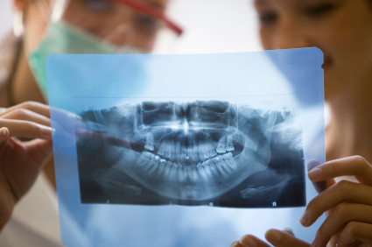

Slide 5
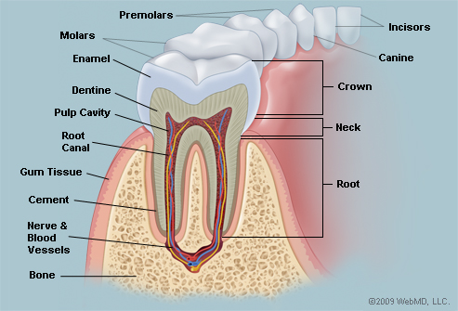

Slide 6
Premolars-třenové zuby
Molars-stoličky
Pulp cavity-dřeňová dutina
Root canal-dřeň
Gum tissue-dáseň
Canine-špičák
Crown-korunka
Neck-krček
Dentine-dentin
Nerve and blood vessels

Slide 7
Thank you for attention ☺
A.Sákrová

